Slide 1

Optimal Accommodation Solutions for Immigrants: Leveraging Geolocational Data Analysis
Presented by
Shobaloju Abdullahi Abolaji
180211052
Supervised by
AJASA, Abiodun Afis PhD
Department of Electronic and Computer Engineering, Lagos State University, Lagos.
7th September, 2023

Slide 2
Presentation Layout
Problem Background
Research Objectives
Scope of the Study
Literature Review
Research Methodology
Results
Conclusion

Slide 3
Problem Background
According to the Nigerian Bureau of Statistics, an average of 485,000 people migrate to Lagos state annually.
This rapid population expansion has brought severe problems in the provision of adequate housing facilities .
Problems related to immigrants’ accommodation require effective practical solutions

Slide 4
Research Objectives
1. To create three machine learning algorithms; K-means clustering, Agglomerative Hierarchical Clustering (AHC), and Principal Component Analysis (PCA) which recommends the most suitable accommodation for immigrants
2. To evaluate, compare and contrast the techniques in the study
3. To determine the most efficient machine learning technique for accommodation recommendation

Slide 5
Scope of the Study
1. The scope of this study is limited to Geographical focus, geolocational data sources, housing attributes and selected immigrants preferences
2. Only three machine learning Algorithms are used for this study
3. Python Programming Language is used for modeling and simulation of the developed algorithm

Slide 6
Significance of the Study
Personalized accommodation recommendation
Efficient resource allocation
Enhanced housing access
Research advancement

Slide 7
Literature Review
SSLR:
Created by Qianfang Xu and co. in 2017 by incorporating both spatial and sequence of a location’s geographical influence. They applied the kernel density estimation approach to specify regional parameters and produce a distinct distribution for each user.

Slide 8
OTPA
Optimal Travel Path Application created by Shabir Ahmad and co. in 2019. An application which suggests visitors optimum travel path according to time, distance and popularity. They used Wi-Fi routers at several locations to obtain tourists’ travel patterns and used Markov chain model to analyze the data

Slide 9
Research Methodology
The techniques applied in this study are Clustering and dimensionality reduction.

Slide 10
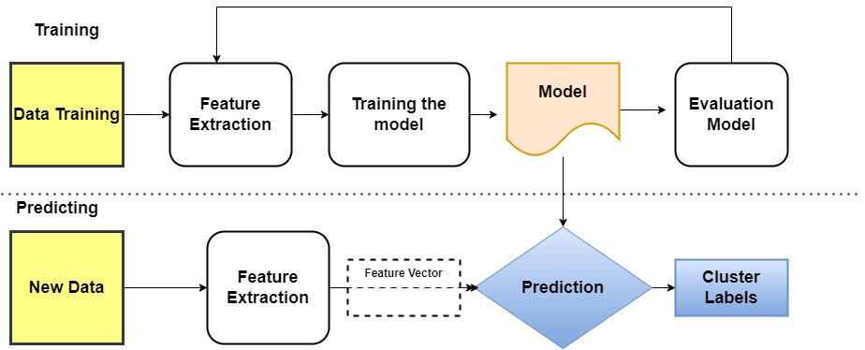
Methodology Flowchart

Slide 11
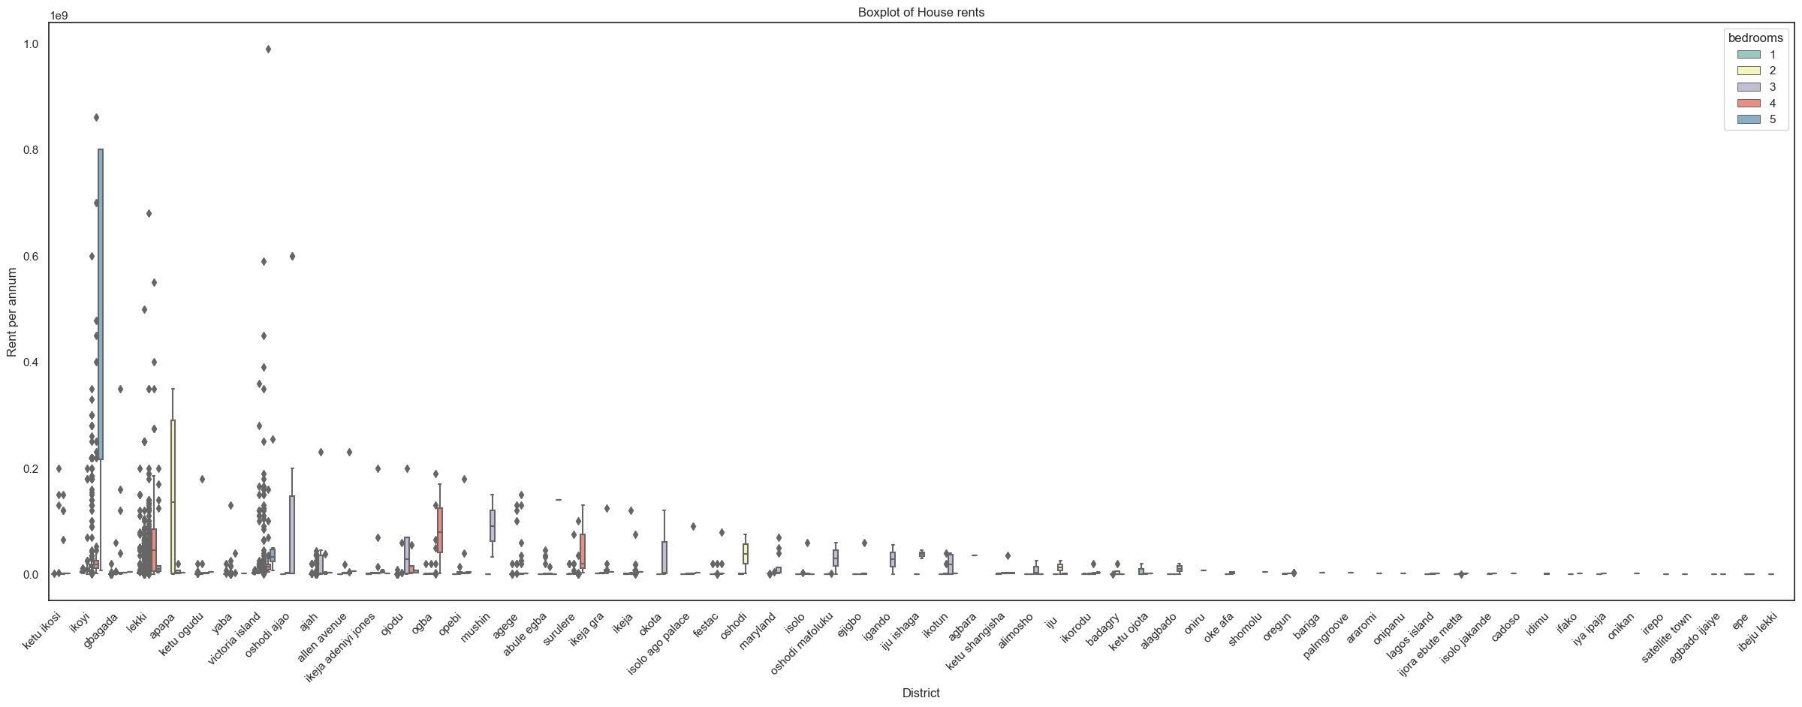
K-means Clustering Result

Slide 12
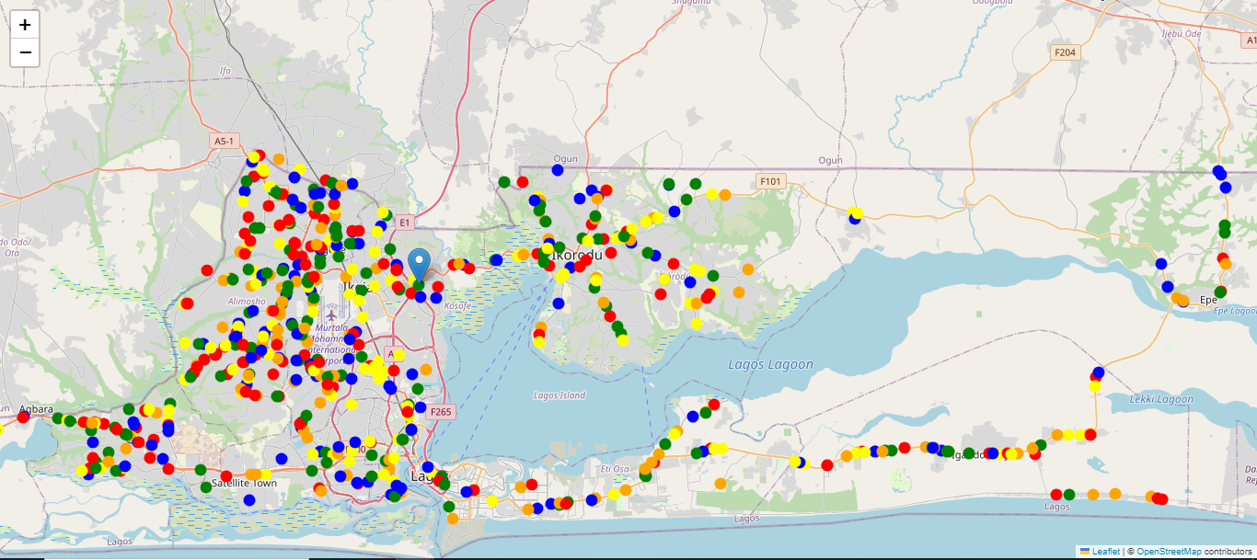

Slide 13
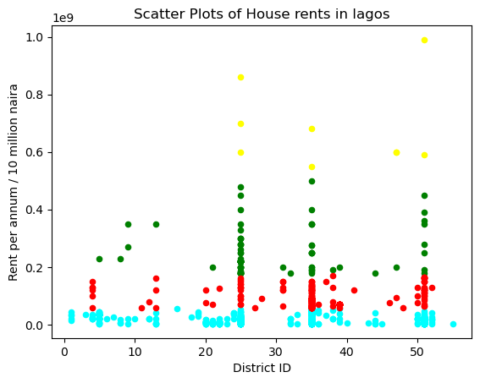
AHC RESULT

Slide 14
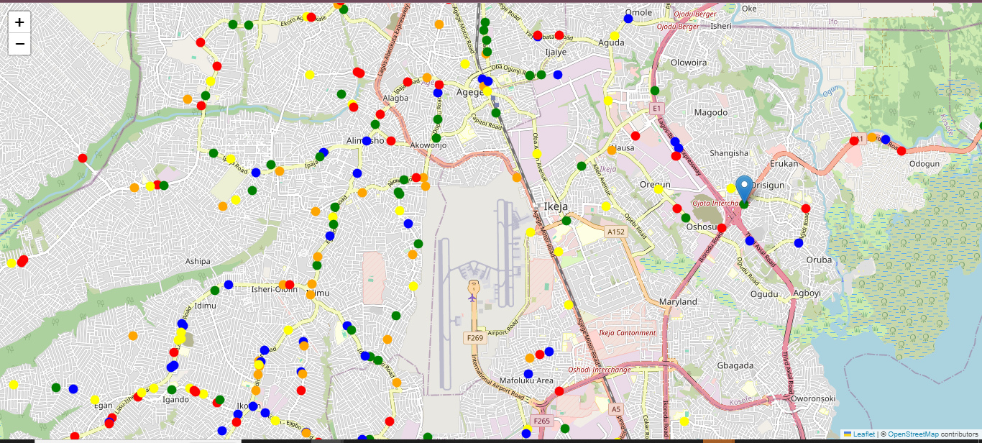

Slide 15
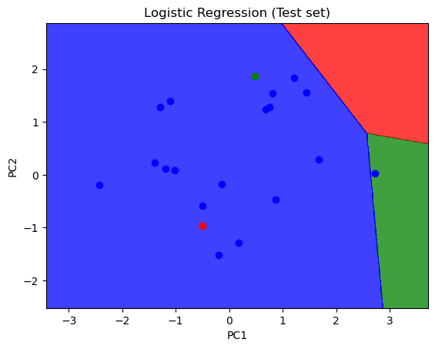
PCA RESULT

Slide 16
COMPARATIVE ANALYSIS
Algorithm | Overall Accuracy | RunTime | Dataset
K-means clustering | 90.5% | 10 Seconds | 20,123
Agglomerative Hierarchical Clustering | 79.33% | 4 minutes, 45 Seconds | 10,000
Principal Component Analysis | 85% | 6 Seconds | 100

Slide 18
Conclusion
In conclusion, using geolocational data analysis to recommend accommodation for immigrants is a strong and effective solution. We can see from our result that K-means clustering is the most effective for accommodation recommendation

Slide 19
References
Kim Cotzias, "The history of Geolocation: modern technology born from Ancient human interest". https://www.geopointe.com/2017/07/11/geolocation-history/ 2017
2. Teng Li, Amin Rezaeipanah and Elsayed M. Tag El Din, "An ensemble agglomerative hierarchical clustering algorithm based on clusters clustering technique and the novel similarity measurement" Journal of king Saud University - Computer and Information Sciences, volume 34, Issue 6, part B, 2022
3. Ian T. Jolliffe and Jorge Cadima, "Principal component analysis: a review and recent developments", Philos Trans A Math Phys Eng Sci. Apr 13; 374(2065): 20150202.doi: 10.1098/rsta.2015.0202, 2016

Slide 20


